Slide 1
Using D2D, the Interlibrary Loan portal
Carleton Place Public Library

Slide 2
How to make an ILL Request
IMPORTANT: Please ensure that you search CPPL’s own catalogue first before making an ILL request. Any requests made for an item that CPPL owns will be cancelled.
https://carletonplace.bibliocommons.com

Slide 3
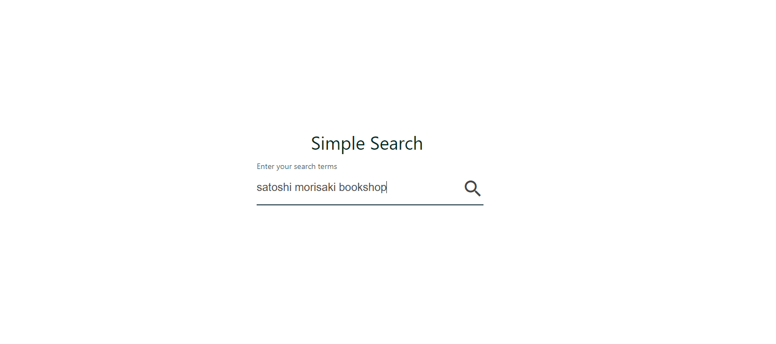
Do a search
Visit CPPL’s ILL website at D2D Search
Search for the item using the title, author’s name, or a combination of both

Slide 4
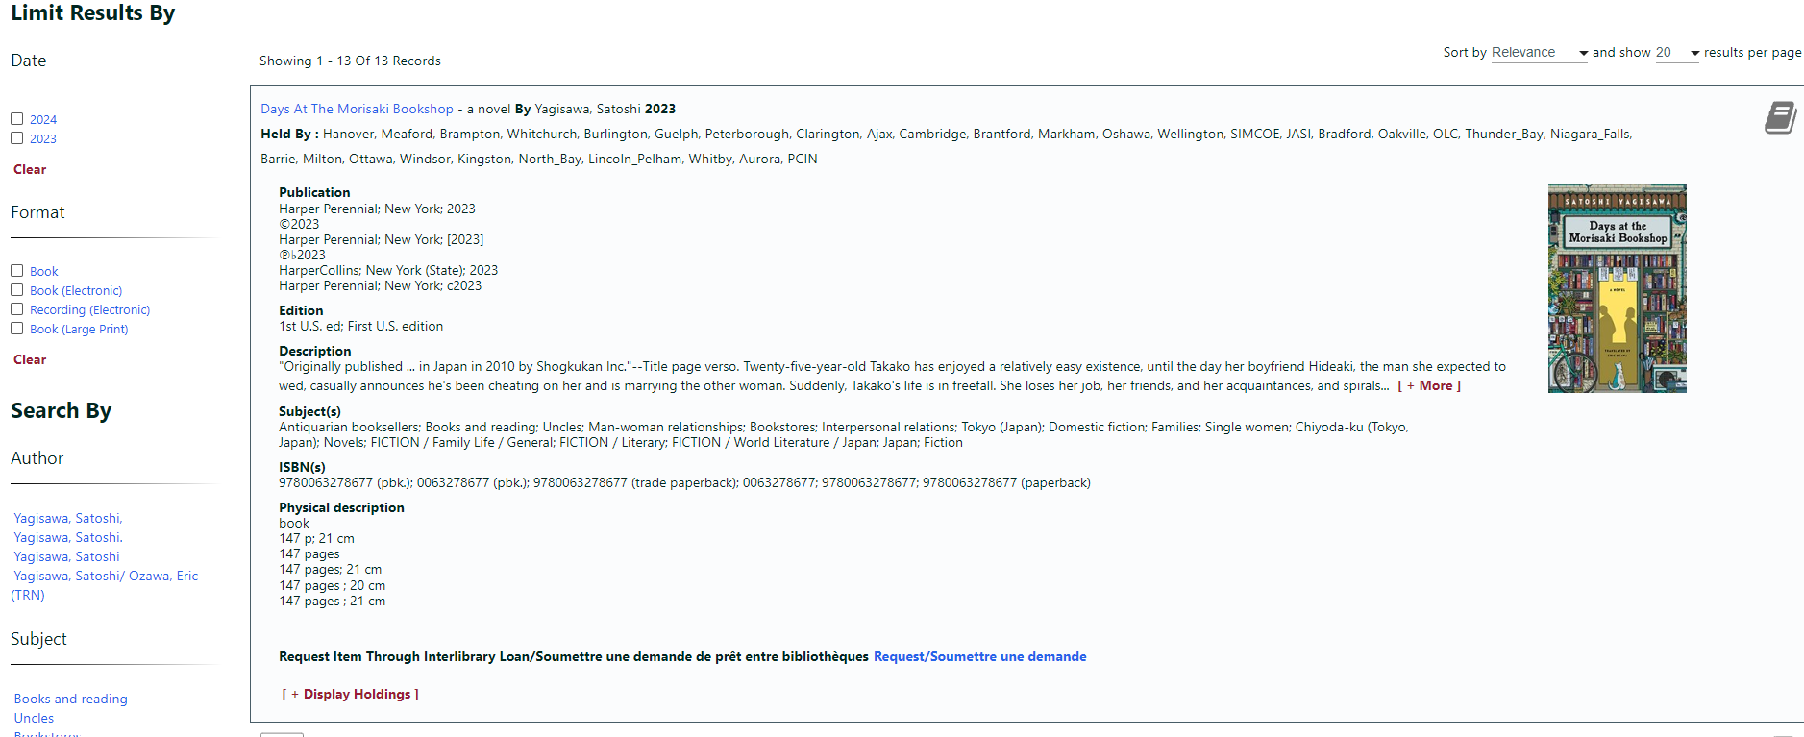
Search results
Click on an item to display the item details. You can also narrow your search results by specific year, format, author, or subject, by using the left side bar
Optional: click “Display Holdings” to determine how many libraries hold this item. The more requestable holdings, the greater chance of a successful request.
Submit your request using the link at the end of the description.

Slide 5
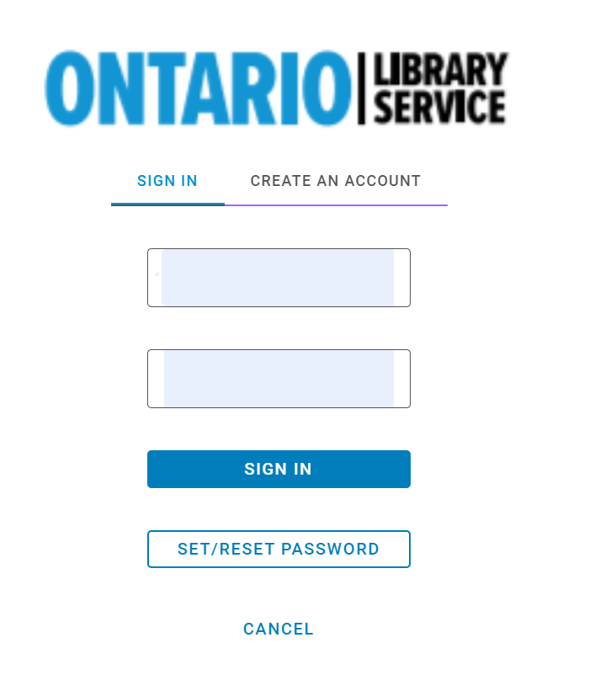
Sign in
After you have hit “Request”, you will be prompted to sign in. If you don’t have an account, you can click on “Create An Account”. If you have an account but don’t remember the password, you can reset it here.

Slide 6
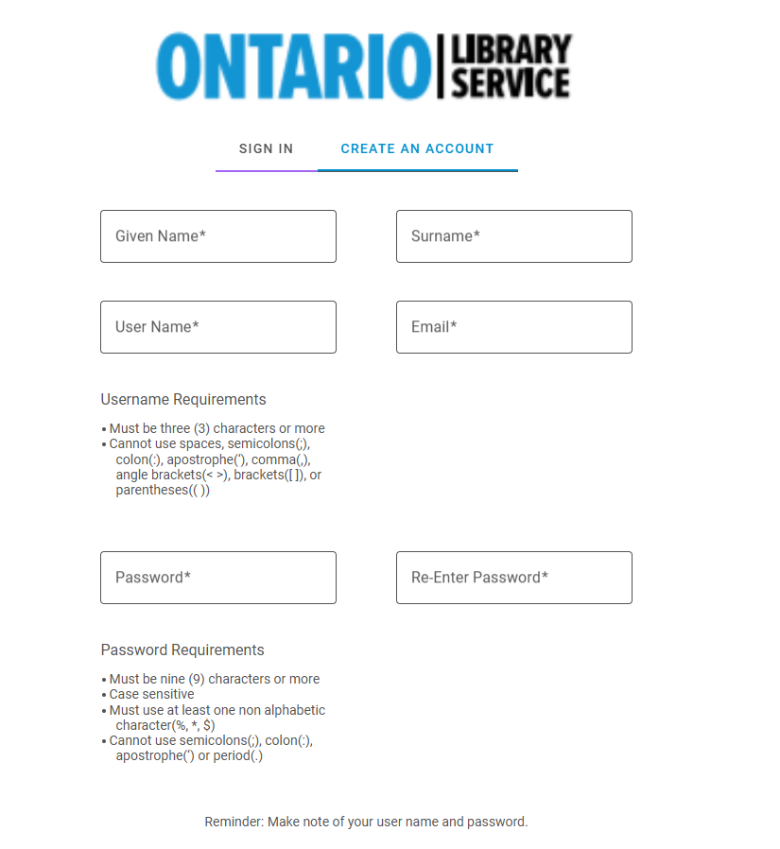
Create an account
Fill out all the required fields to create a new account.
Make a note of your user name and password
Our library must approve all new accounts. This may take up to 48 hours.

Slide 7
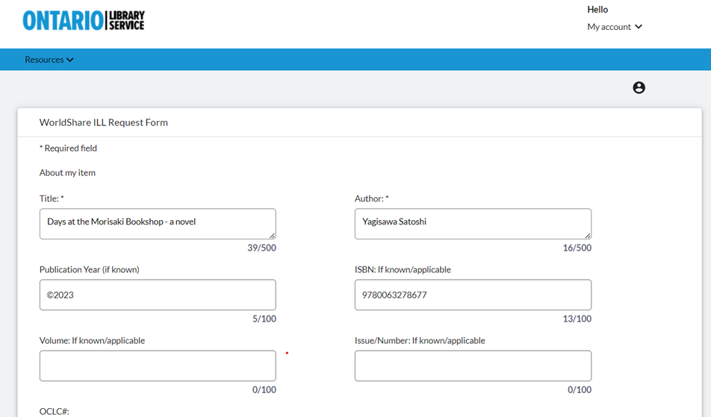
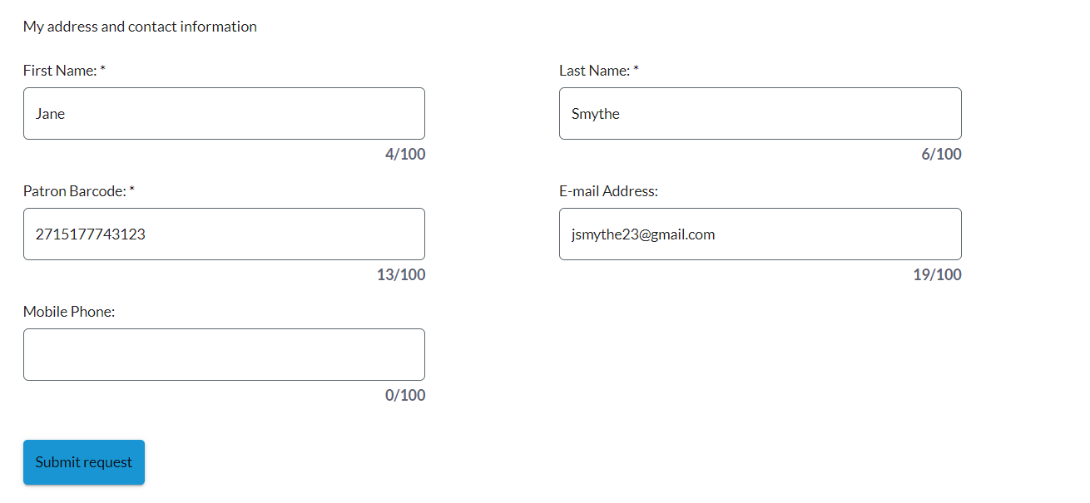
Request Form
The details for your request and contact information will appear onscreen. Click the Submit button at the bottom of the screen to complete the request.

Slide 8
Request complete
You will receive confirmation on screen and by email, and your requests will show up on your profile.

Slide 9
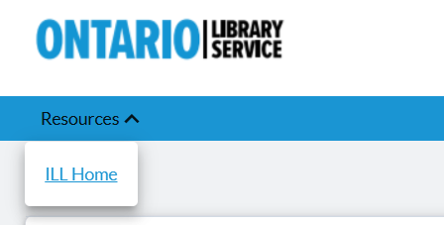
Return to Home Page
After placing a request, you can return to the main page to do another search by navigating to the Place a Request link under the Resources menu on the top left of your screen

Slide 10
Limits
Our library has a limit of 3 (three) active interlibrary loan requests per person. An active request includes anything you have requested from another library that is in progress, or that you have received. You will see warning on screen if you exceed the limit on active requests.
Items that you have returned and that have been received by the lending library, and requests that you have cancelled are not accounted as active.

Slide 11
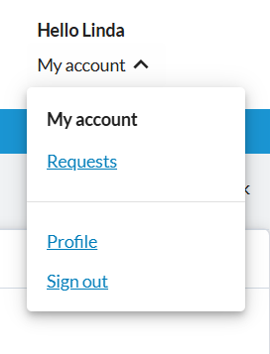
Sign out
When you are done searching for items and placing requests, you can sign out using the My Account menu on the top right on the screen

Slide 12
Using My Account in D2D

Slide 13
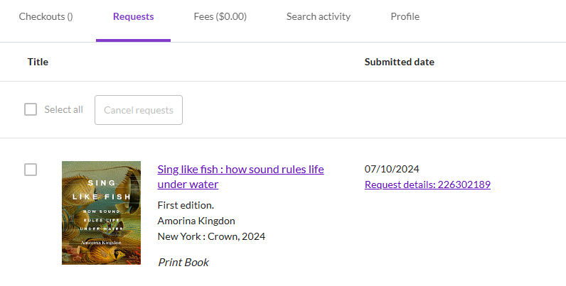
My Account
My Account allows you to track your current ILL requests

Slide 14
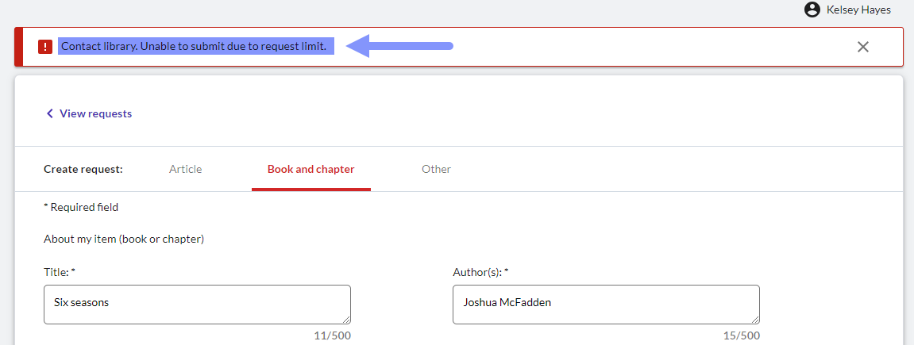
Patron Request Limits
You may have up to 3 (three) active ILL requests at a time
When you reach the limit, an error message will display, and the request cannot be submitted

Slide 15
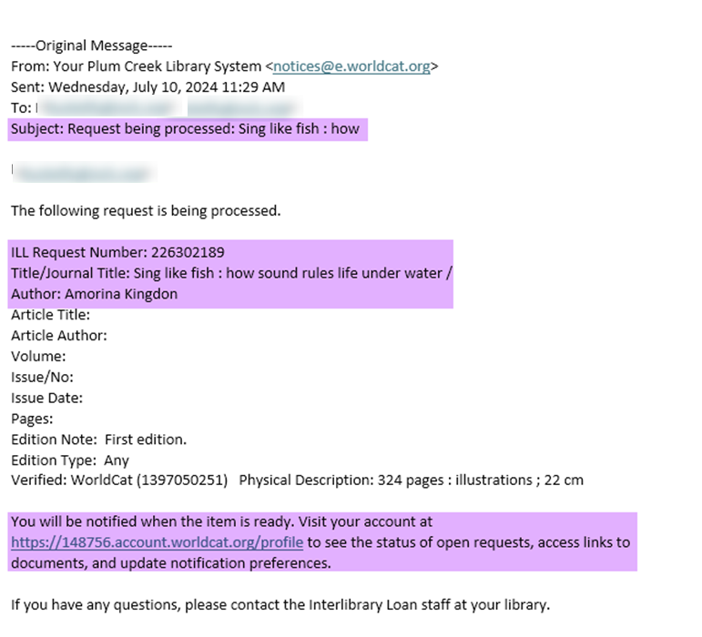
Notifications about your interlibrary loan are emailed to the address associated with your account
They will provide details on the request (in process, ready for pickup, return reminders)
Notes:
Ready for pickup

Slide 16
Cancel ILL requests

Slide 17
Cancel ILL Requests
Once your request has been reviewed by staff and sent out for fulfillment (may take up to 48 hours), the item will be eligible for cancellation.
If a lending library has not started processing the ILL request, the request will have a Selection box and can be chosen for cancellation
One canceled, the request will still appear in My Account, but will indicate it has been cancelled

Slide 18
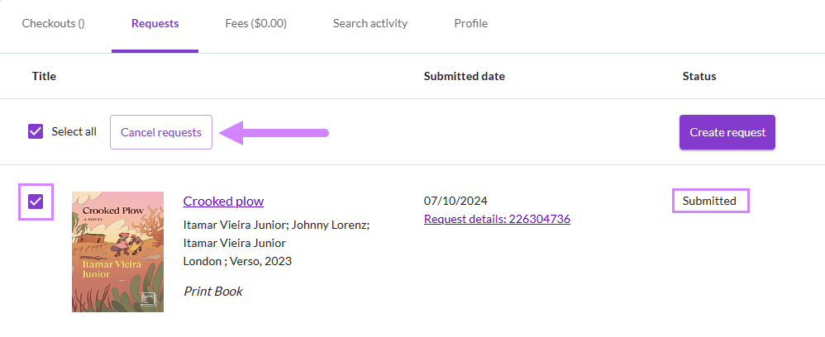
Cancel ILL requests

Slide 19
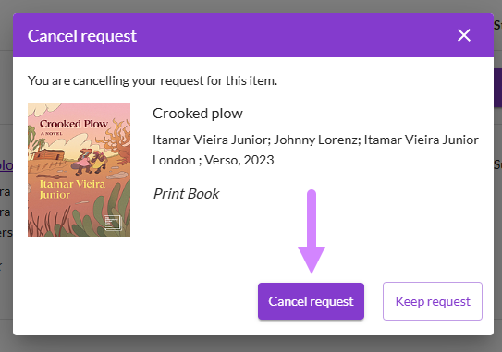
Cancel ILL requests

Slide 20
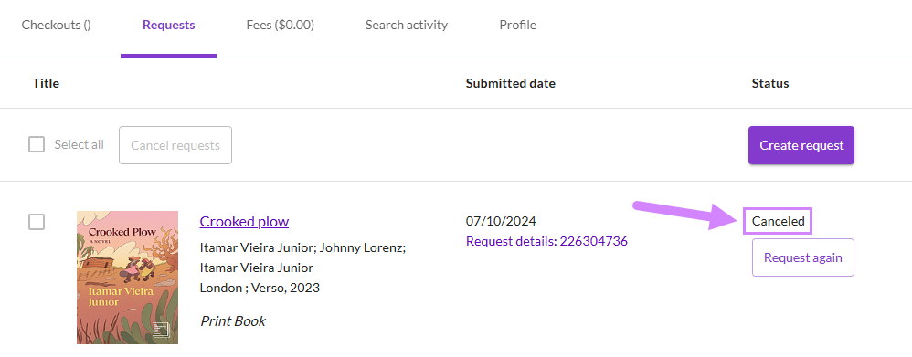
Cancel ILL requests

Slide 21
Thank you!

